Slide 1
Strings

Slide 2
Strings
A string is defined as null terminated character array.
A string must be terminated by a null – means that we need one byte extra for holding null character.
A string constant is null-terminated by the compiler automatically.
Each character takes one byte in string.

Slide 3
Read Strings from Keyboard
There are several ways-
Using scanf() function-
for string C use “%s” format specifier
#include <stdio.h>
#include <stdlib.h>
int main()
{
char string[100];
printf("Enter a whole sentence: ");
scanf ("%s", &string);
printf ("You entered: %s", string);
return 0;
}
Most common is: gets()

Slide 4
gets()
C’s standard library function
uses the STDIO.H header file
To use – call it using the name of a character array without any index.
gets() function reads character until we press ENTER
The ENTER key (carriage return - \r) is not stored, but is replaced by a null, which terminates the string.
char str[100];
gets(str);

Slide 5
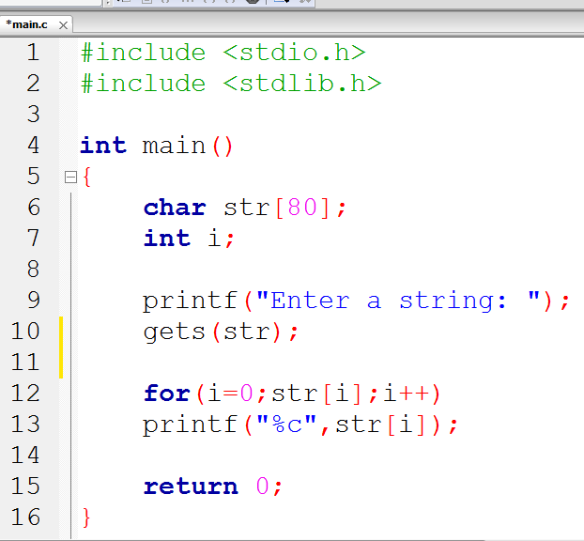
gets() …
page 145
Here null is false
to control the loop
that output the string

Slide 6
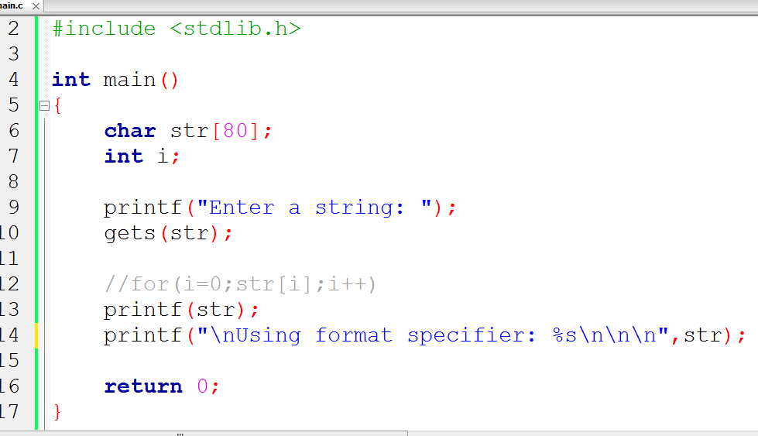
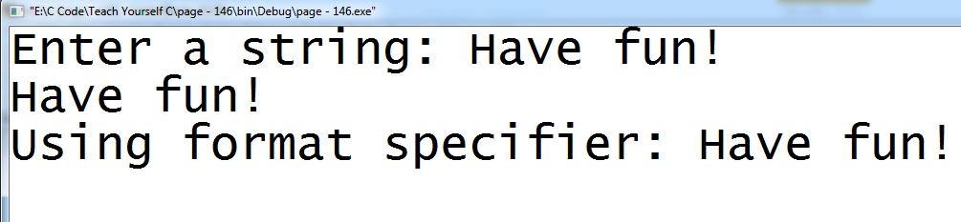

Slide 7
gets() - Be aware!
The get() function performs no bounds checking.
It is possible to enter more characters than the array receiving them can hold – unwanted result!
For example, if we call gets() with an array that is 20 characters long, there is no mechanism to stop us from entering more than 20 character.

Slide 8
puts()
C’s standard library function
uses the STDIO.H header file
To use – call it using the name of a character array without any index.
char str[100] = “This is it”;
puts(str);

Slide 9
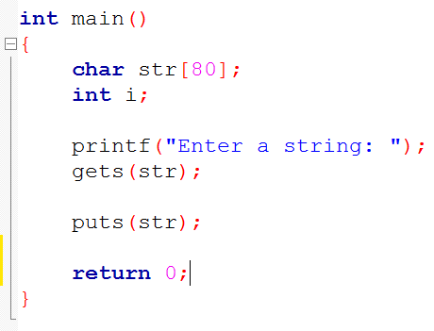
puts()
Example

Slide 10
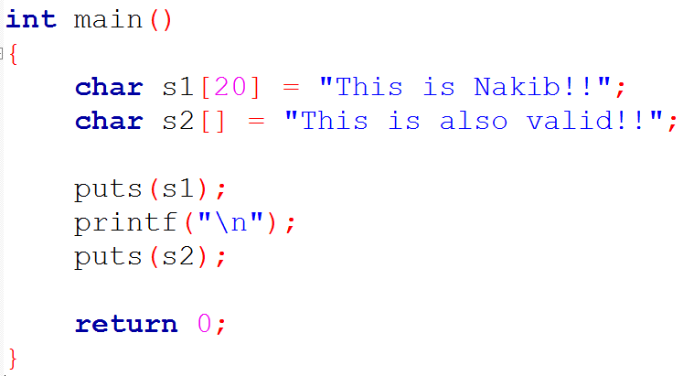
Initialize String
Example

Slide 11
STRING.H
The four most string related library functions are
strcpy() – for copy
strcat() – for concatenation
strcmp() – for compare two strings
strlen() – for finding length of a string

Slide 12
strcpy()
It copies the contents of from to to.
strcpy (to, from);

Slide 13
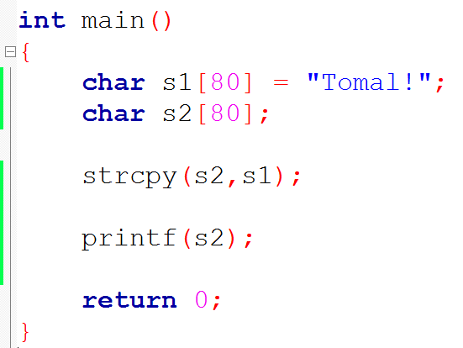
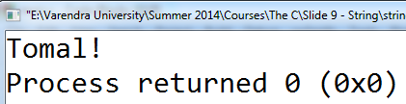
strcpy()
String – strcpy 1

Slide 14
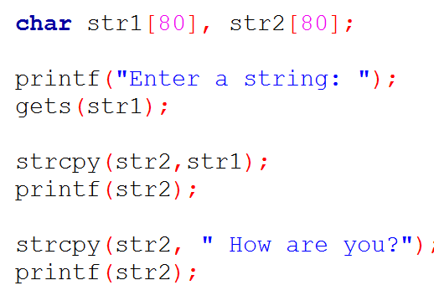
strcpy()
String – strcpy 2

Slide 15
strcat()
strcat (to, from);
adds the contents of one string (from) to another (to).

Slide 16
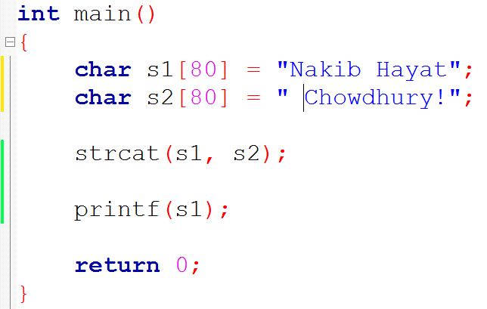
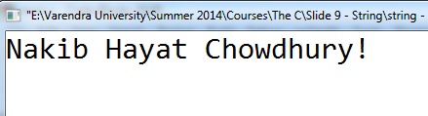
strcat()
strcat()

Slide 17
strcmp()
strcmp(s1,s2);
It returns zero – if s1 and s2 same (s1 = s2)
It returns less than zero – if s1 less than s2 (s1 < s2)
It returns greater than zero – if s1 greater than s2 (s1 > s2)

Slide 18
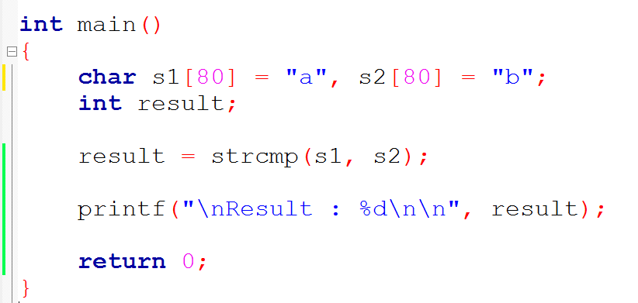
strcmp()
Example 1
Example 2

Slide 19
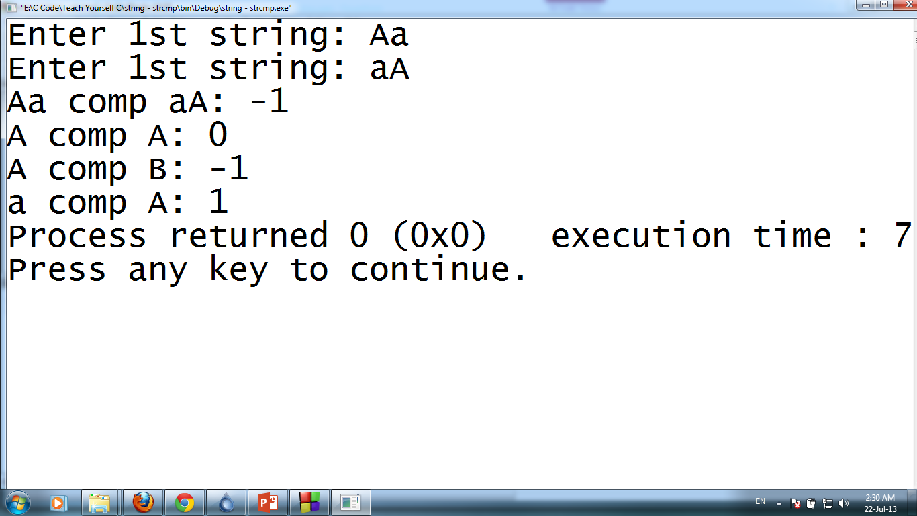
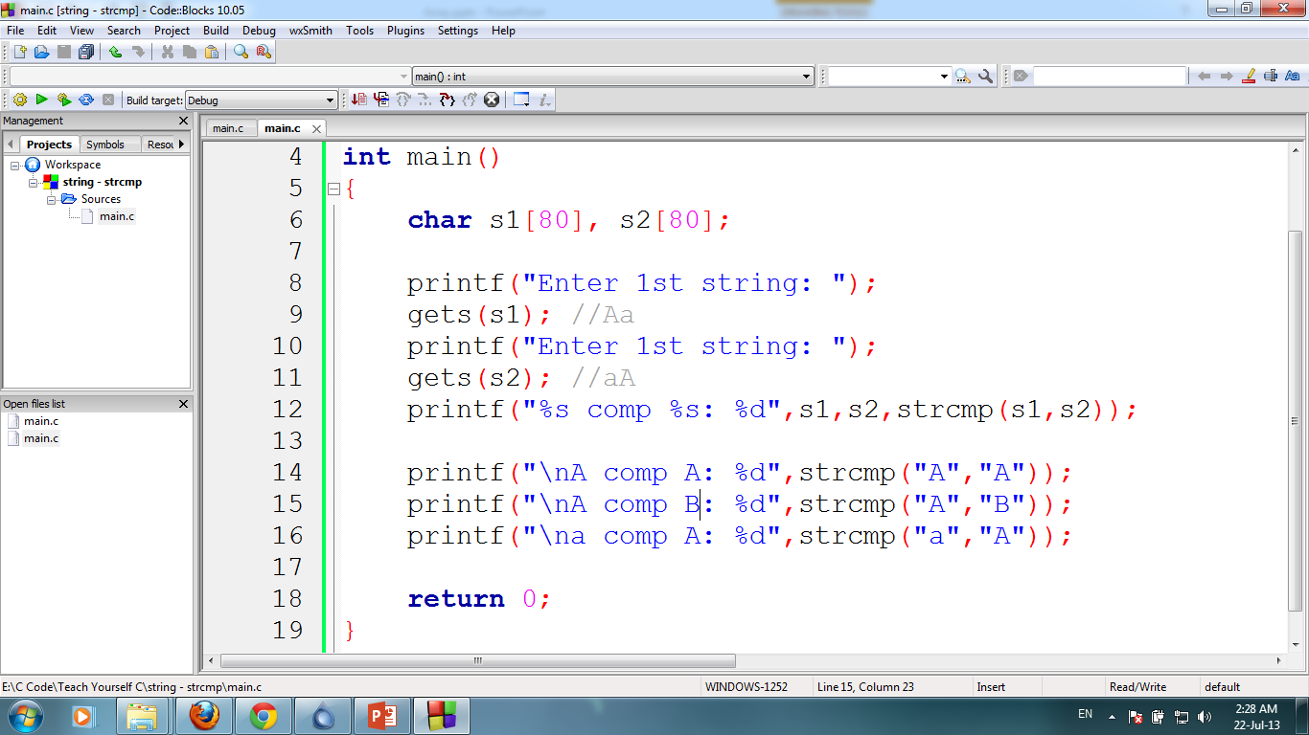

Slide 20
strlen()
strlen (str);
returns the length, in characters of a string.
It does not count the null terminator

Slide 21
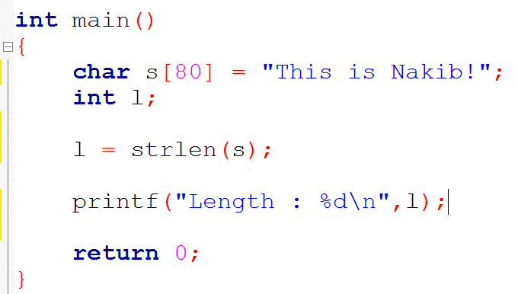
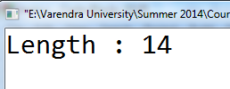
strlen()
Example

Slide 22
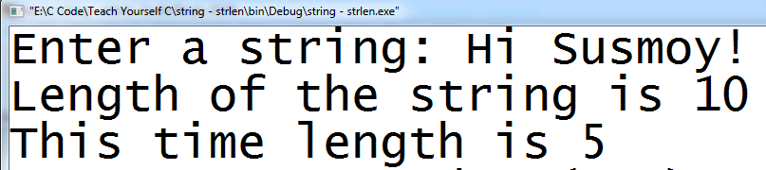
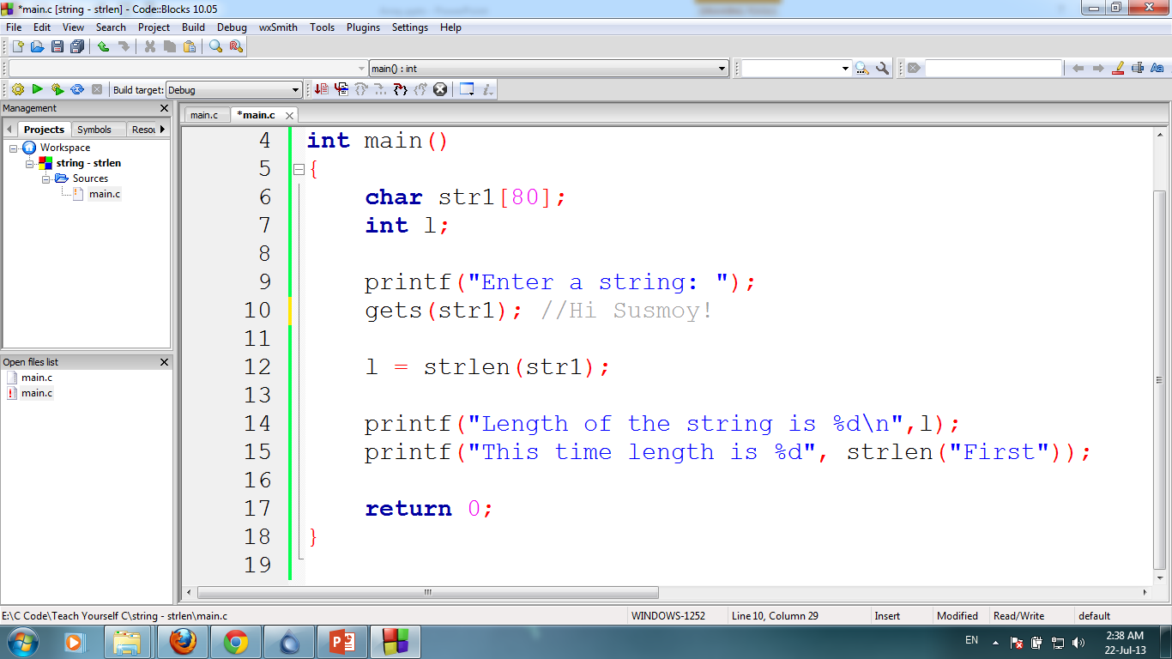

Slide 23
strrev()
returns the string in revers order.
It does not count the null terminator
Example
strrev (str);

